Slide 1
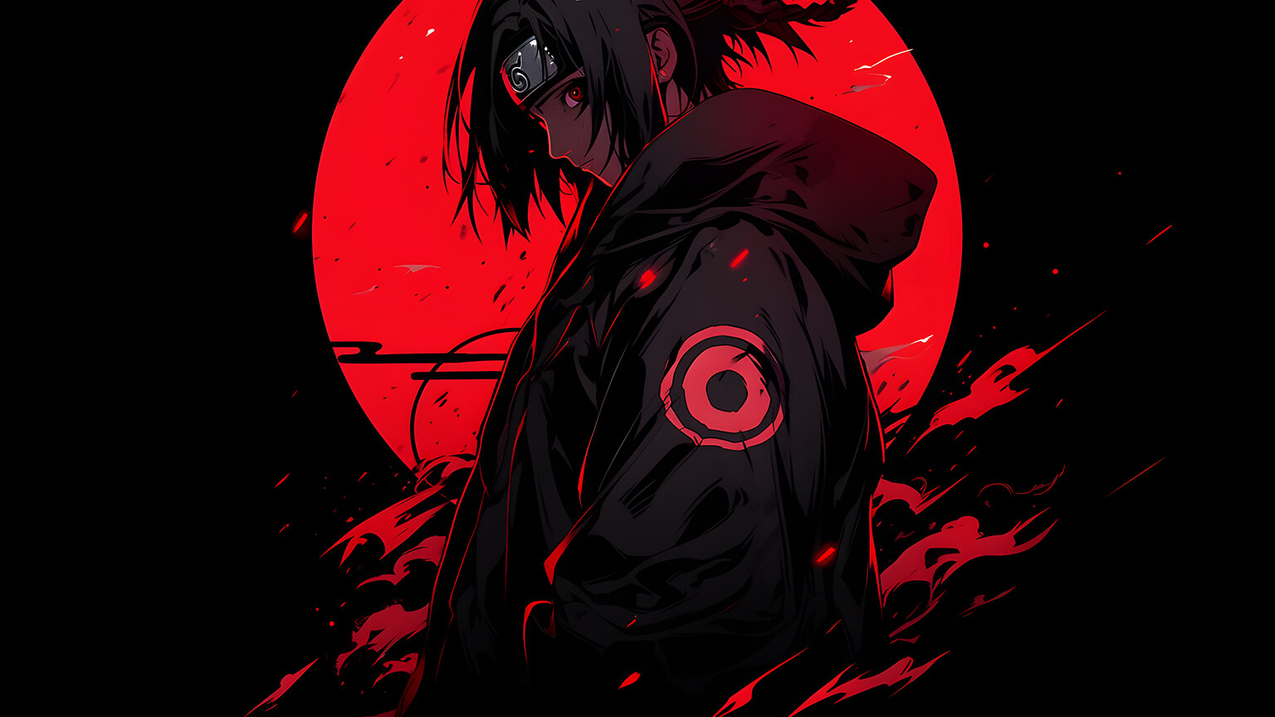
Anime & History

Slide 2
The Precursors

Slide 3

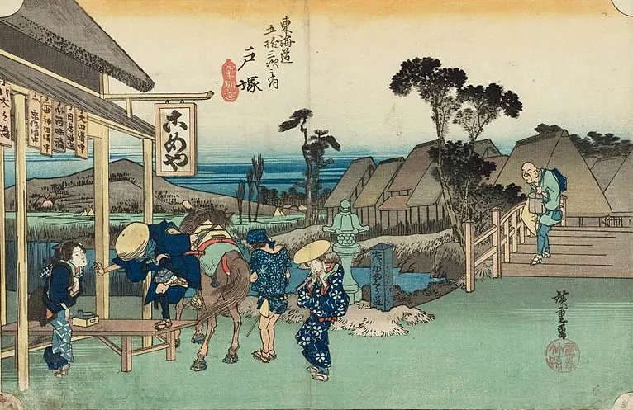
Tokugawa Period: 1603 - 1867
Japan's Isolation (Sakoku) and Peace:
Notes:
During the Tokugawa period, Japan experienced more than 200 years of relative peace and isolation from the rest of the world. This era, also known as the Edo period, was marked by a stable and rigid social structure.

Slide 4
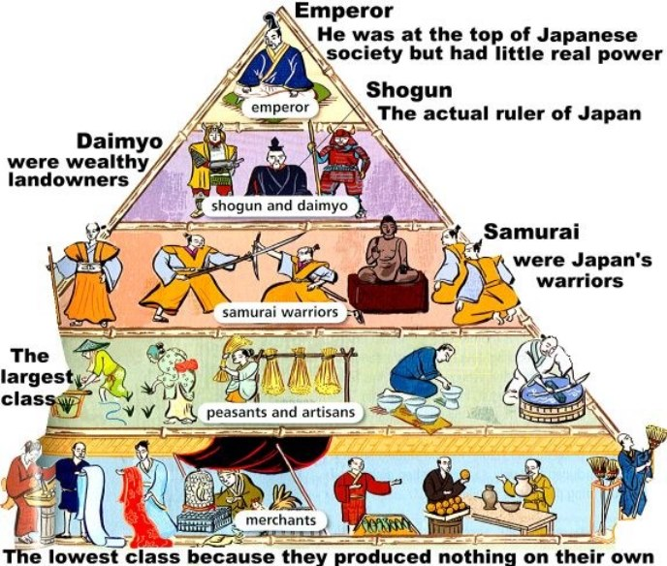
Tokugawa Period: 1603 - 1867
Class Hierarchy:
Notes:
Japanese society was organized into strict hereditary classes. At the top was the emperor, who served as a symbolic figurehead. True political and military power rested with the Tokugawa shogun, a dynasty of military dictators. Below the shogun were the feudal lords (daimyo), who controlled various regions.

Slide 5
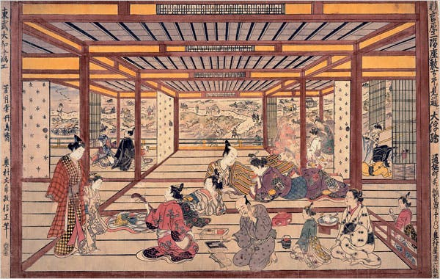
Tokugawa Period: 1603 - 1867
Samurai Class:
Notes:
The samurai were at the top of the social hierarchy. With the country at peace, many samurai found themselves with ample leisure time and stipends. This patronage supported the flourishing of arts and performance, creating cultural hubs known as floating worlds (ukiyo).

Slide 6
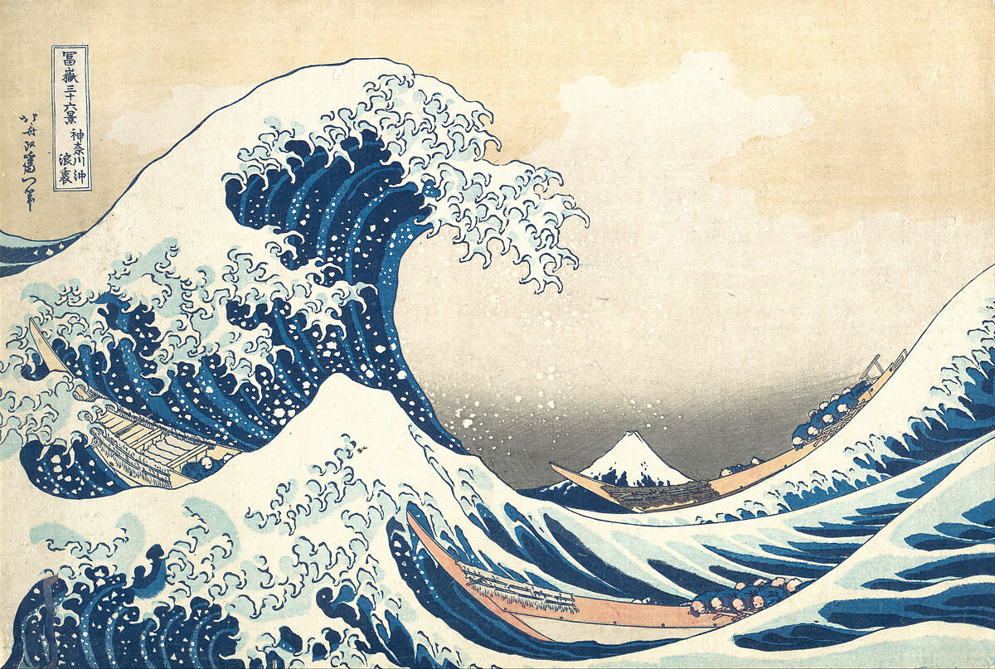
Tokugawa Period: 1603 - 1867
Art and Performance:
Notes:
The floating worlds became centers of artistic and cultural activity. Kabuki theater and puppet shows gained popularity, and woodblock printing became an iconic art form. Artists like Hokusai gained fame both in Japan and abroad. Despite Japan's isolationist policies, some Western cultural and technological influences made their way into the country through limited trade.

Slide 7
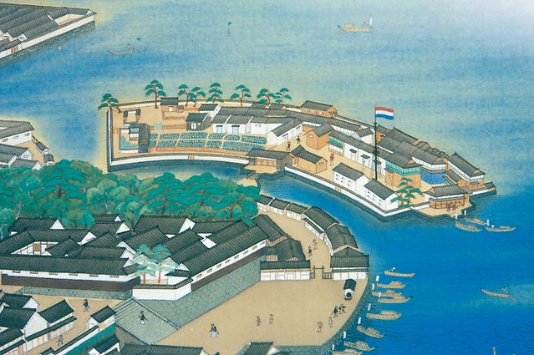
Western Influence and Technological Adoption
Dejima Trading Post
Notes:
The artificial island of Dejima, off the coast of Nagasaki, served as Japan's sole window to the outside world. Initially used by Portuguese traders, it later became a Dutch trading post after the shogun banned Christianity and restricted foreign influence.

Slide 8
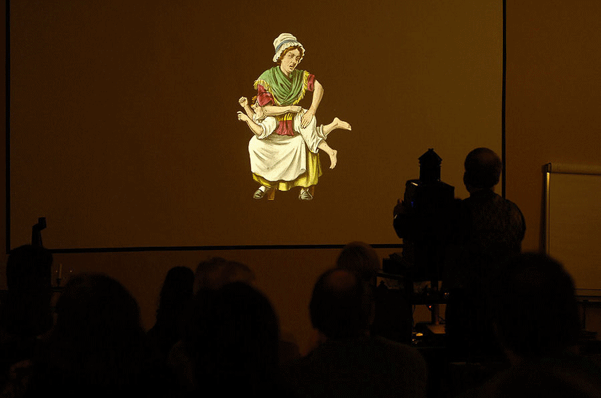
Western Influence and Technological Adoption
Magic Lantern
Notes:
Among the technologies introduced by the Dutch was the magic lantern, an early device for projecting images painted on glass slides. It was used for educational purposes and entertainment, offering a rudimentary form of animated storytelling and laying the groundwork for future developments in Japanese cinema and animation.

Slide 9
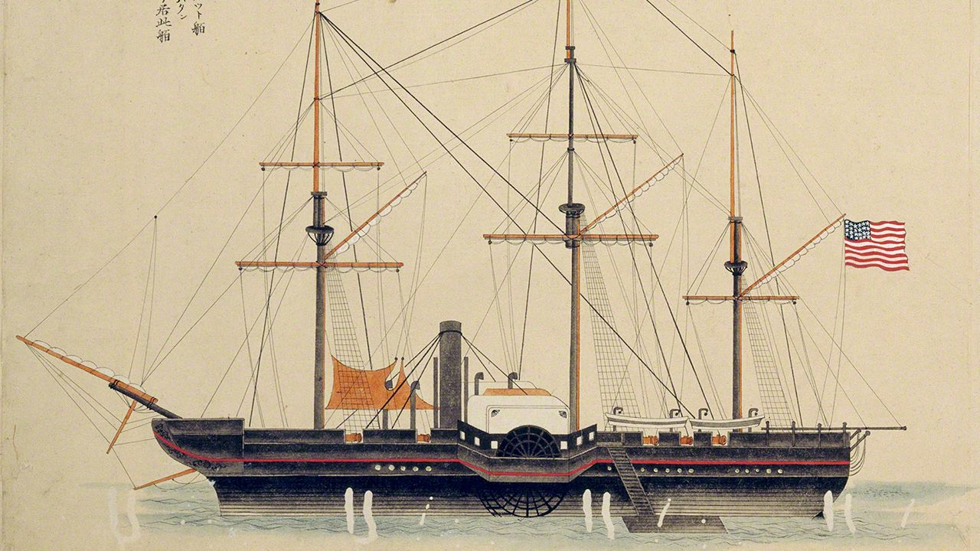
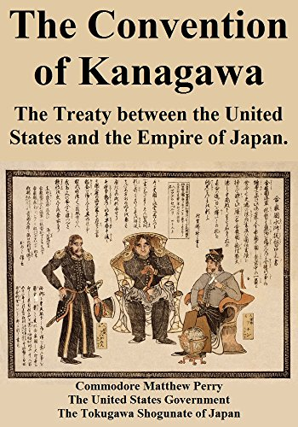
The Arrival of the Black Ships and Meiji Restoration
American Demands:
Notes:
In the mid-19th century, American naval forces, known as the Black Ships, arrived in Japan, demanding the opening of trade. The Japanese, technologically outmatched and fearing destruction, signed trade agreements with the United States. This event marked the end of Japan's isolation.

Slide 10
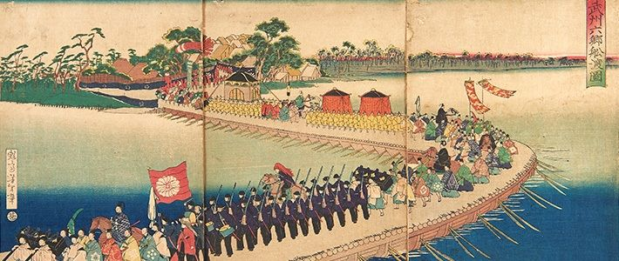
The Arrival of the Black Ships and Meiji Restoration
Internal Strife and Unification:
Notes:
The arrival of the Black Ships exposed the weaknesses of the shogunate government. In response, the samurai class led a revolution that restored the emperor to power, resulting in the Meiji Restoration. This shift aimed to unify the country and modernize rapidly to resist Western dominance.

Slide 11
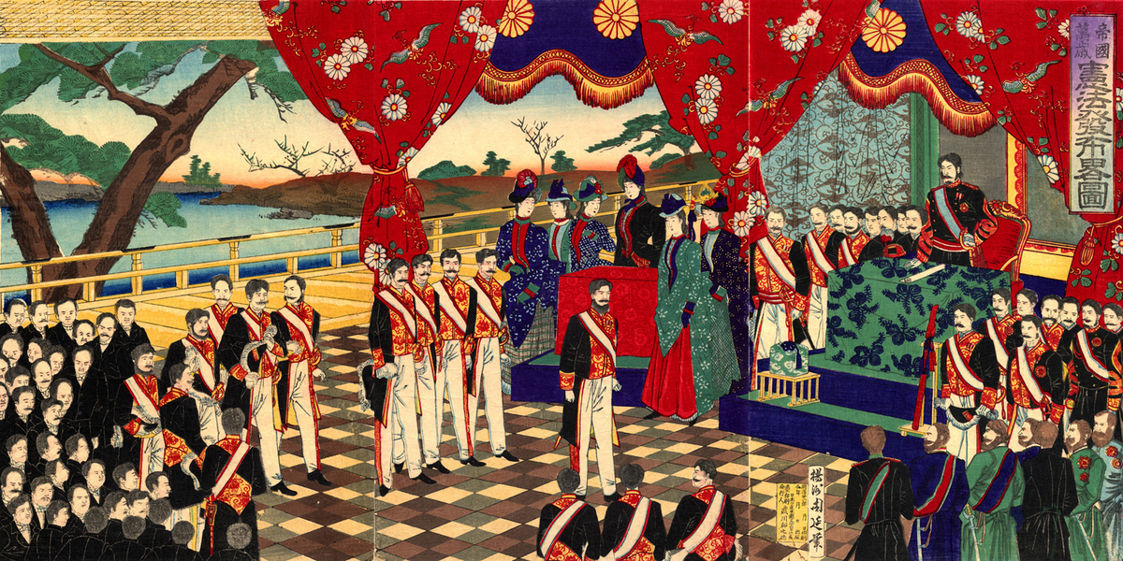
The Arrival of the Black Ships and Meiji Restoration
Meiji Reforms:
Notes:
Under Emperor Meiji, Japan underwent extensive reforms to modernize the nation. Feudalism was abolished, and land ownership was transferred to the state. The class system was dismantled, and Western fashion and customs were adopted. The samurai, who had once been the ruling class, lost their stipends and privileges, transforming Japanese society fundamentally.

Slide 12
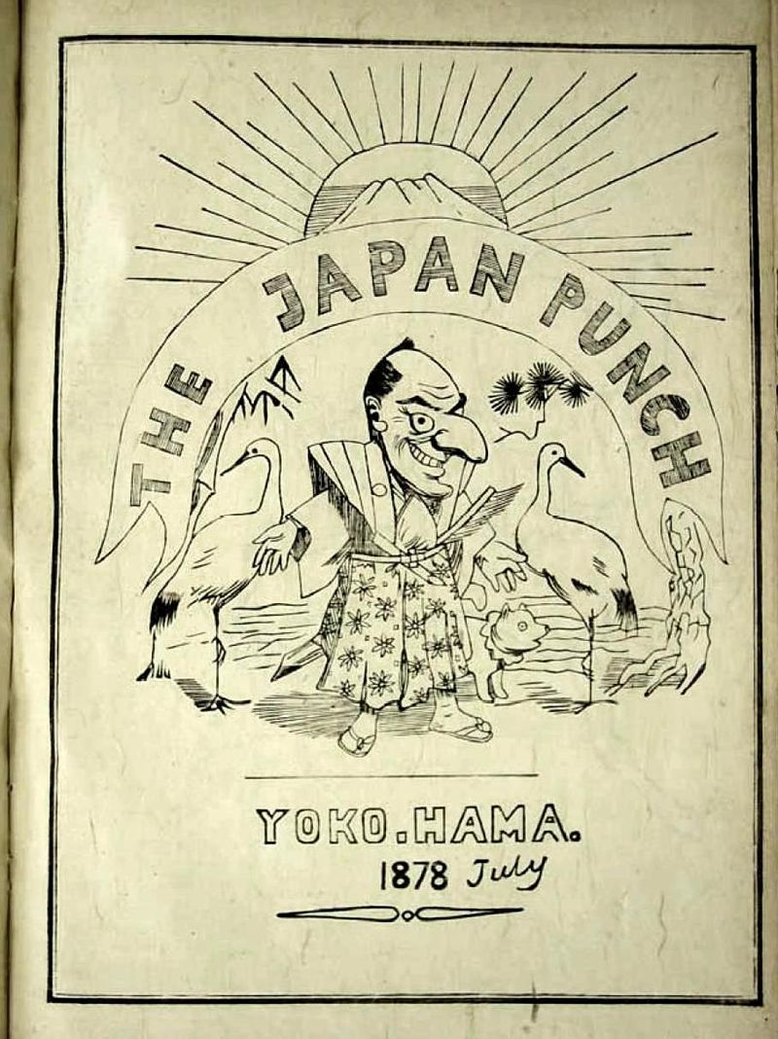
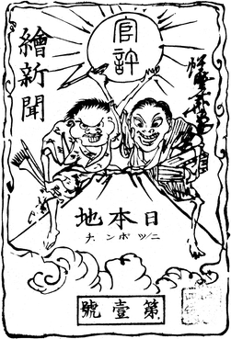
Cultural Transformation and Manga
Introduction of Western Comics:
Notes:
Western cultural influences continued to seep into Japan. Englishman Charles Workman published "Japan Punch," introducing Western comic styles. These styles were adapted and evolved into Japanese cartoon magazines, such as "Eshibon Nipanchi," which catered to a rapidly growing literate population.

Slide 13
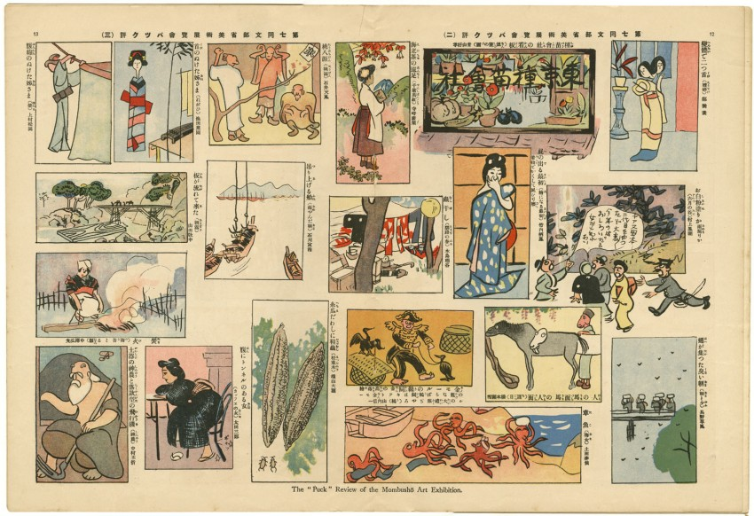
Cultural Transformation and Manga
Manga and Merchandising:
Notes:
The term "manga," referring to Japanese comics and graphic novels, was first used by Rakuten Kitazawa. He is often considered the father of modern manga and played a significant role in its development and commercialization.

Slide 14
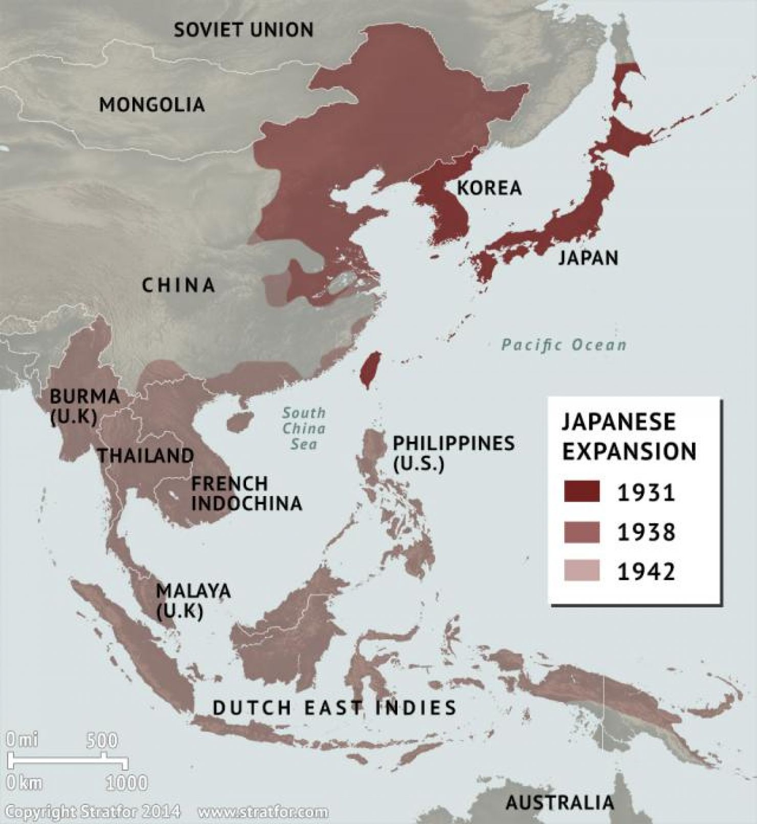
Japanese Imperial Expansion and Cinema
Japanese Expansionism:
Notes:
Japan emulated Western imperialism by expanding its territory and influence. After Japanese sailors were killed by aboriginals on Taiwan, Japan invaded the island, demanding reparations from China. Japan also used military force to open Korea to international trade.

Slide 15
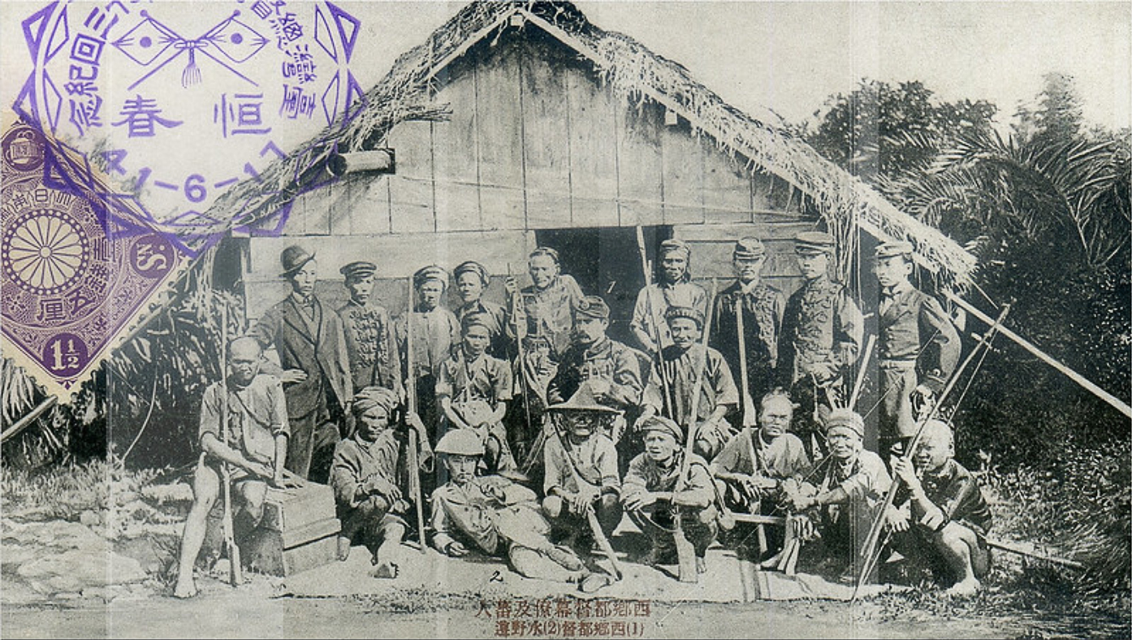
Japanese Imperial Expansion and Cinema
Sino-Japanese War:
Notes:
Tensions with China led to the First Sino-Japanese War. Japan's modernized military quickly defeated China, securing control over Taiwan, the Liaodong Peninsula, and influence over Korea. The Treaty of Shimonoseki formalized these gains, demonstrating Japan's success in adopting Western-style expansionism.

Slide 16
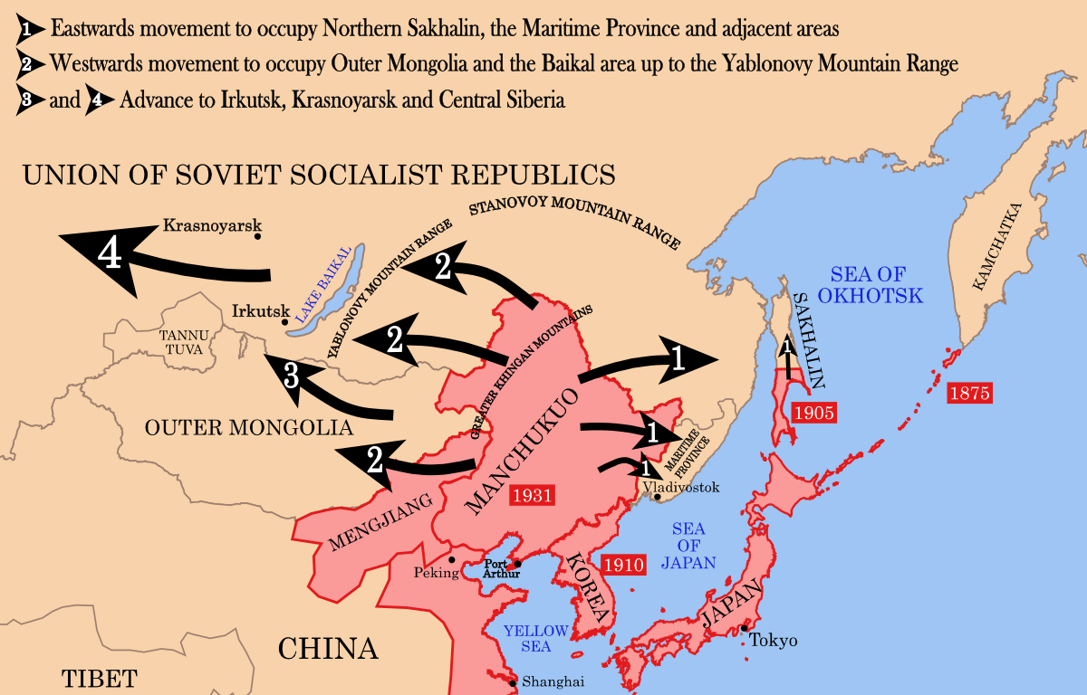
Japanese Imperial Expansion and Cinema
Russo-Japanese War:
Notes:
Japan's ambition clashed with Russian interests in Korea and Manchuria, leading to the Russo-Japanese War. Despite heavy losses on both sides, Japan emerged victorious, marking the first time an Asian nation defeated a Western power in modern warfare.

Slide 17
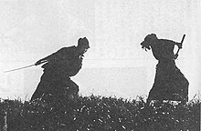
Japanese Imperial Expansion and Cinema
Cinema and Animation:
Notes:
In 1903, Tokyo opened its first cinema, which coincided with Japan's military victories. The film footage of these events captivated audiences and marked the beginning of Japanese animation as a form of entertainment.

Slide 18
The Golden Era – 1980s

Slide 19
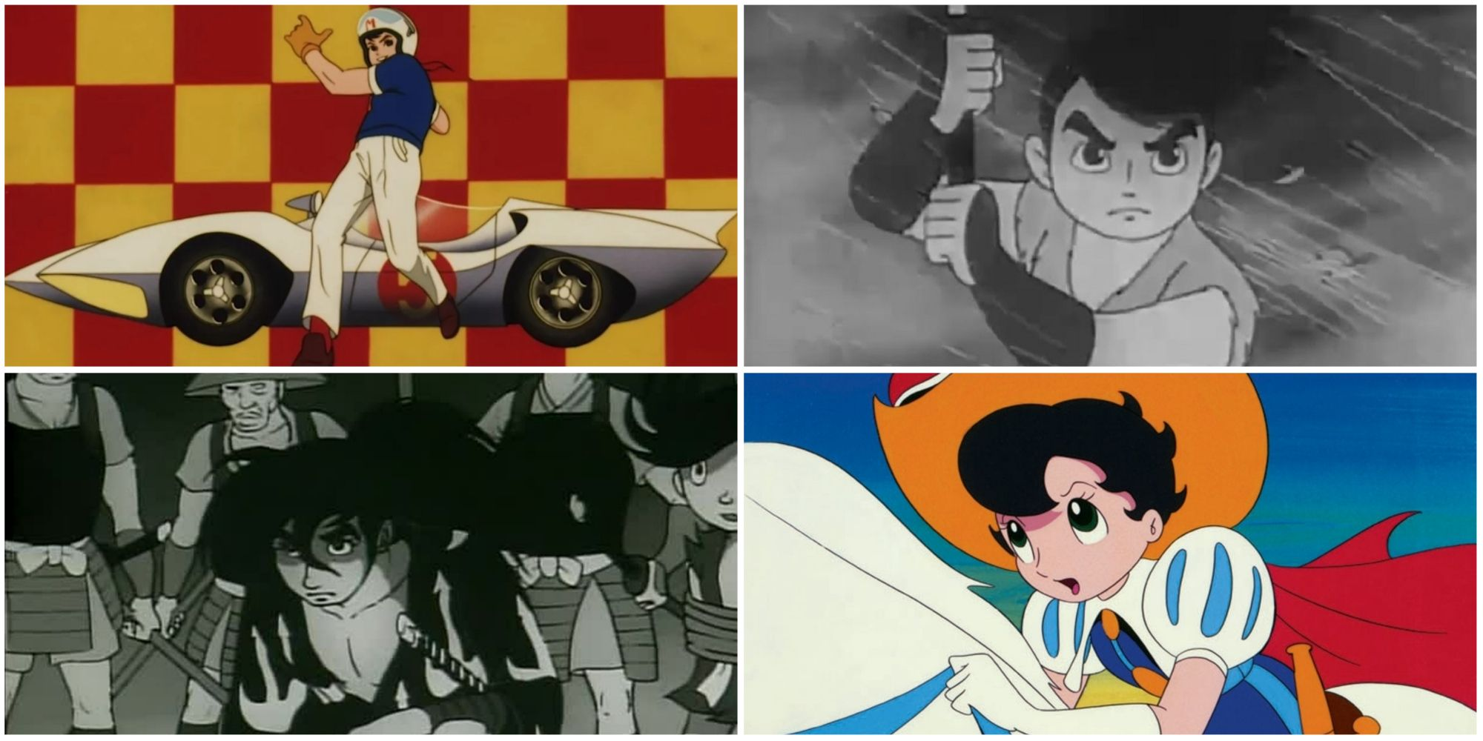
Early Attempts and Struggles (1960s)
First Steps in America:

Slide 20
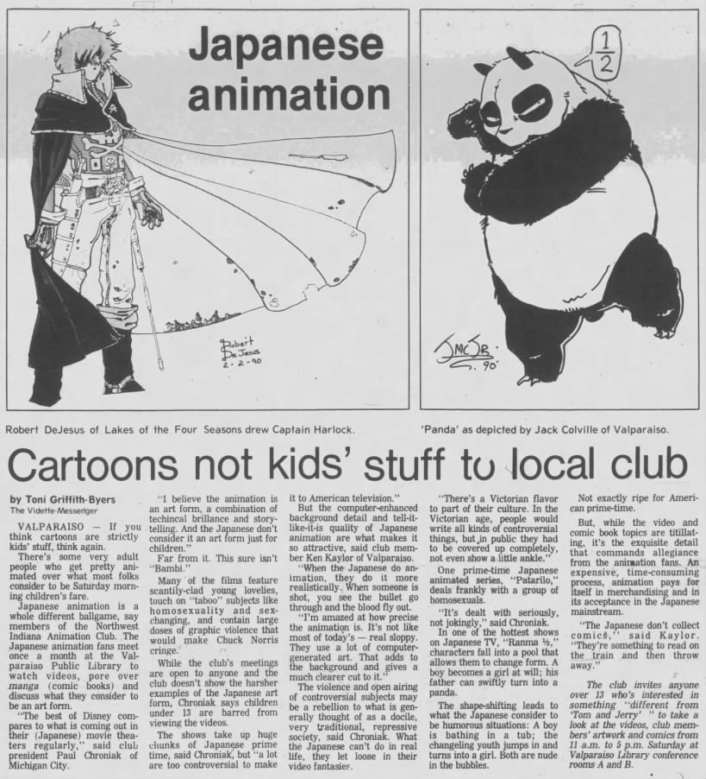
Early Attempts and Struggles (1960s)
Challenges:

Slide 21
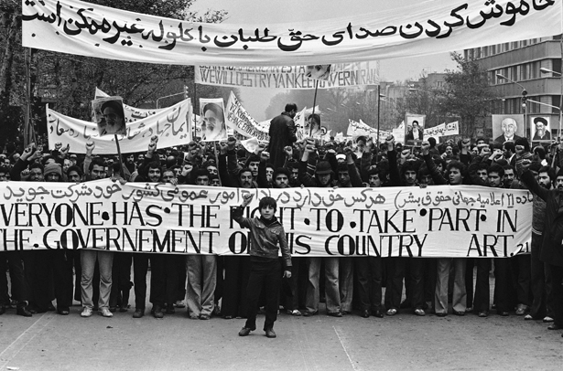
Iranian Revolution - 1979
Global Response:

Slide 22
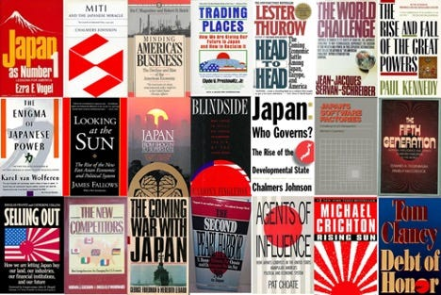
Iranian Revolution - 1979
Japan's Economic Policies:

Slide 23
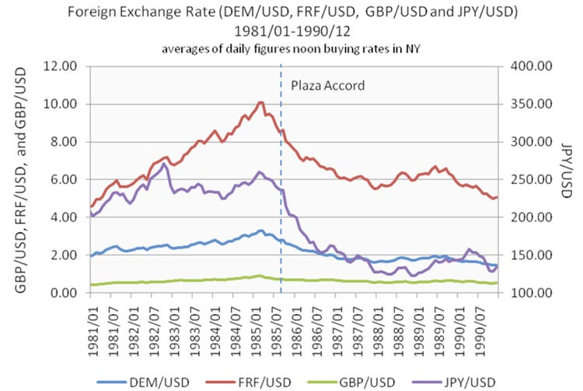
The Plaza Accord and Economic Impact (1985)
Further Interest Rate Cuts:

Slide 24

Economic Boom and Consumer Prosperity (Mid to Late 1980s)
Impact on the Anime Industry:

Slide 25
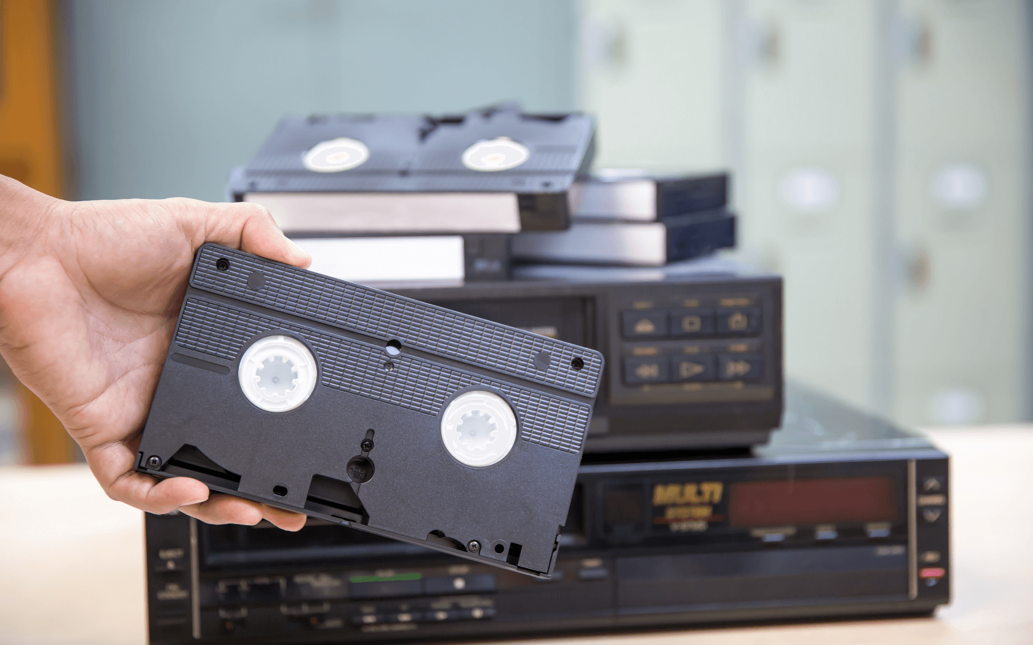
The VHS Era and Rising Popularity (1980s)
The VHS Revolution:

Slide 26
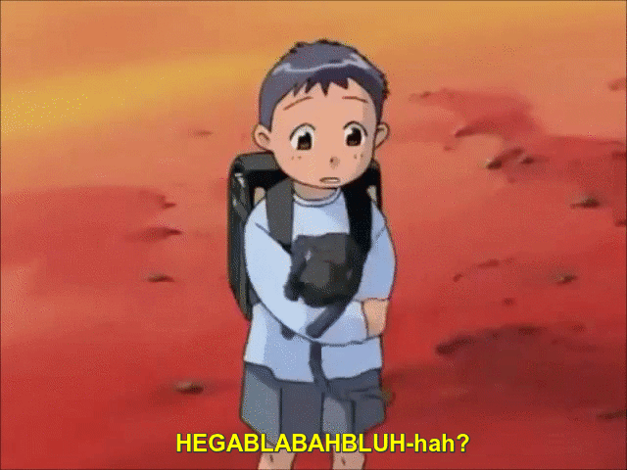
The VHS Era and Rising Popularity (1980s)
Challenges with Adaptation:

Slide 27
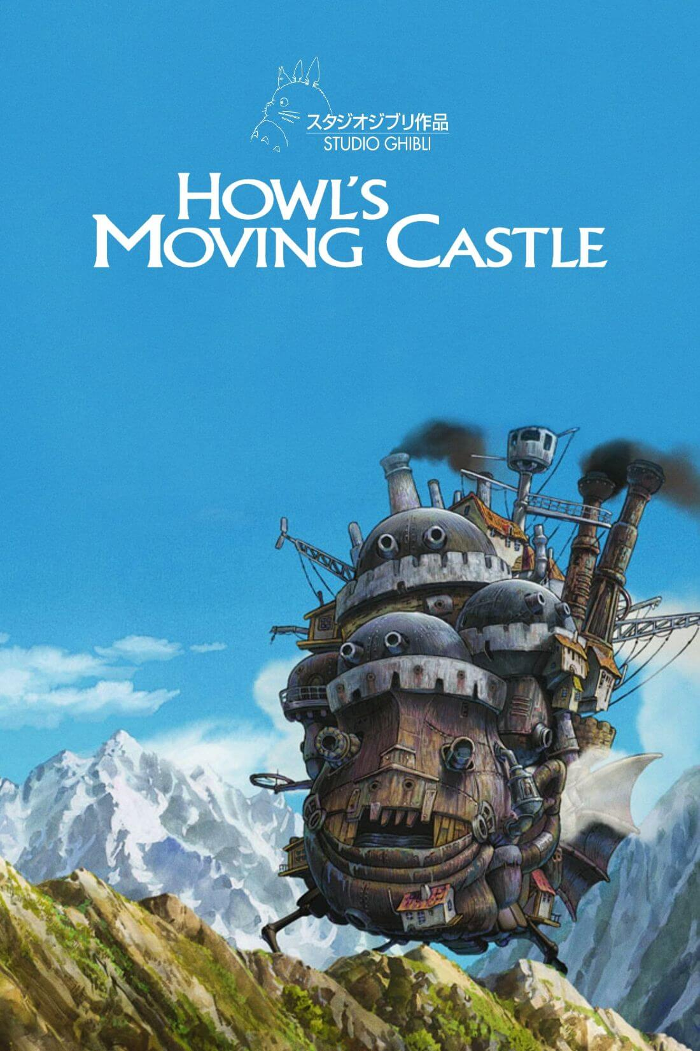
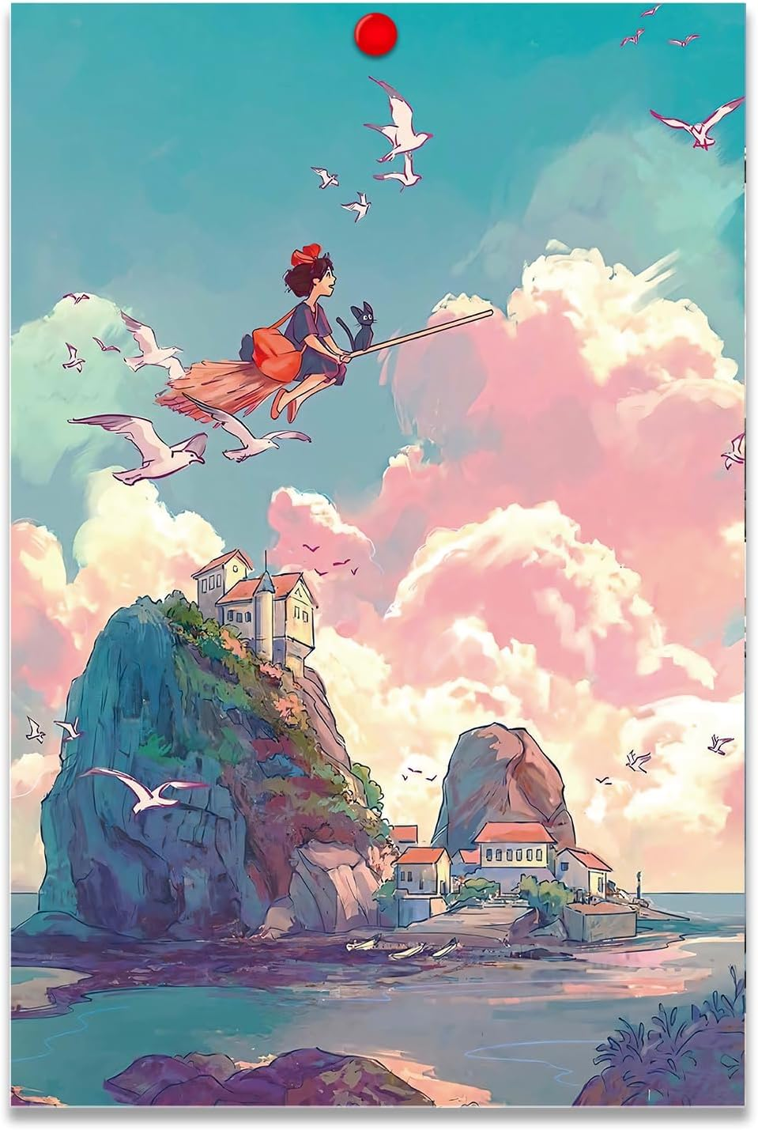
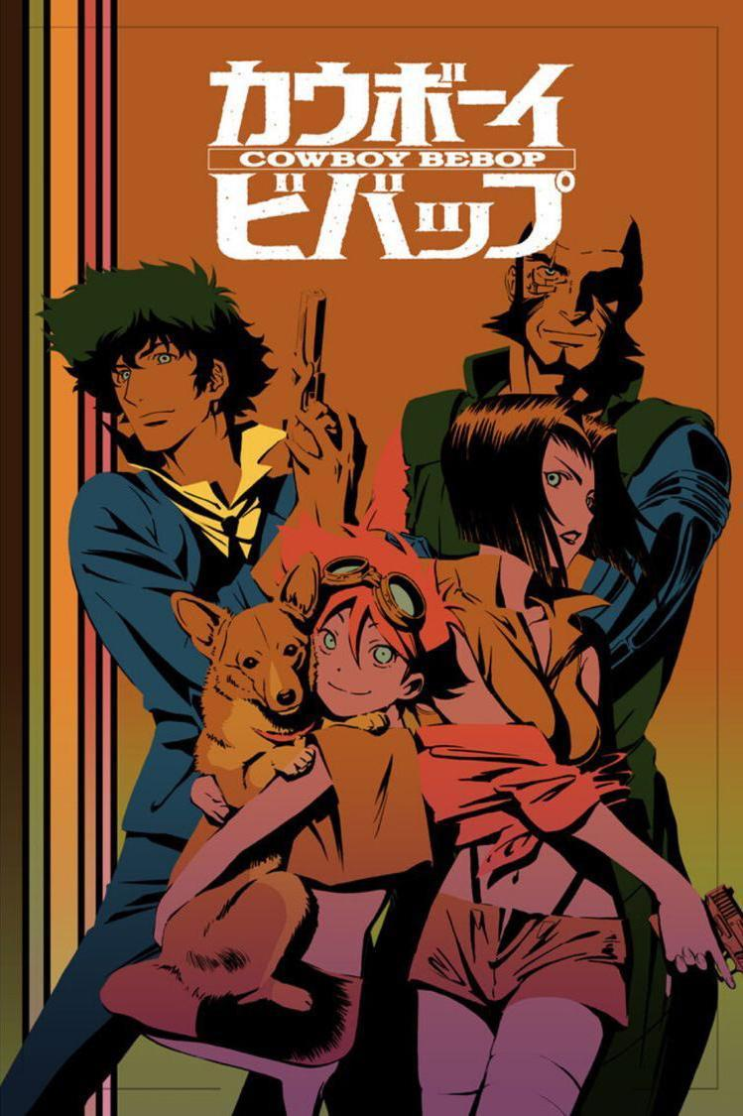
The Golden Age of Anime (Late 1980s to Early 1990s)
Landmark Titles and Studios:

Slide 28

The Golden Age of Anime (Late 1980s to Early 1990s)
Fan Subbing and Accessibility:

Slide 29
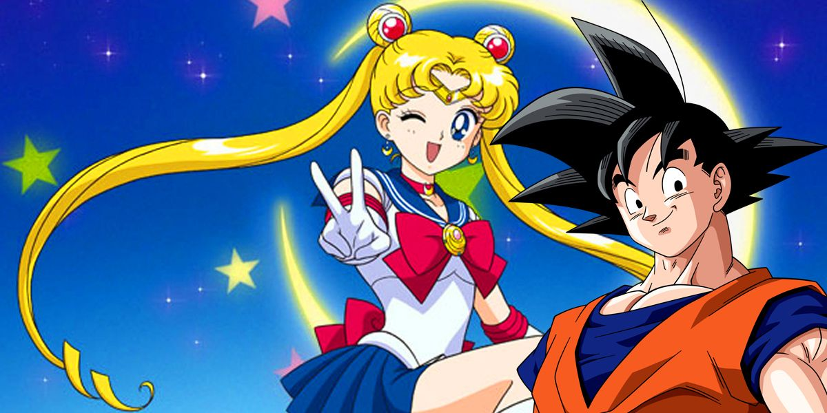
The Climax of the Golden Age (Late 1990s)
Transition to Television:

Slide 30

The Climax of the Golden Age (Late 1990s)
Future Generations:

Slide 31
Anime & Japan

Slide 32
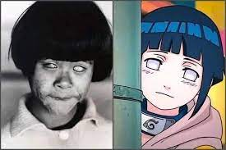
Impact of Japan in Anime
The hyuuga:

Slide 33

Impact of Japan in Anime
Your Name:

Slide 34
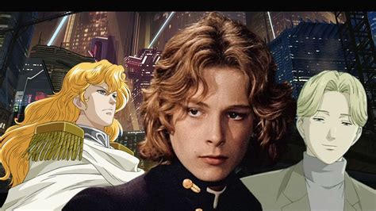
Impact of Japan in Anime
Prettiest Boy (Bjorn Anderson)

Slide 35
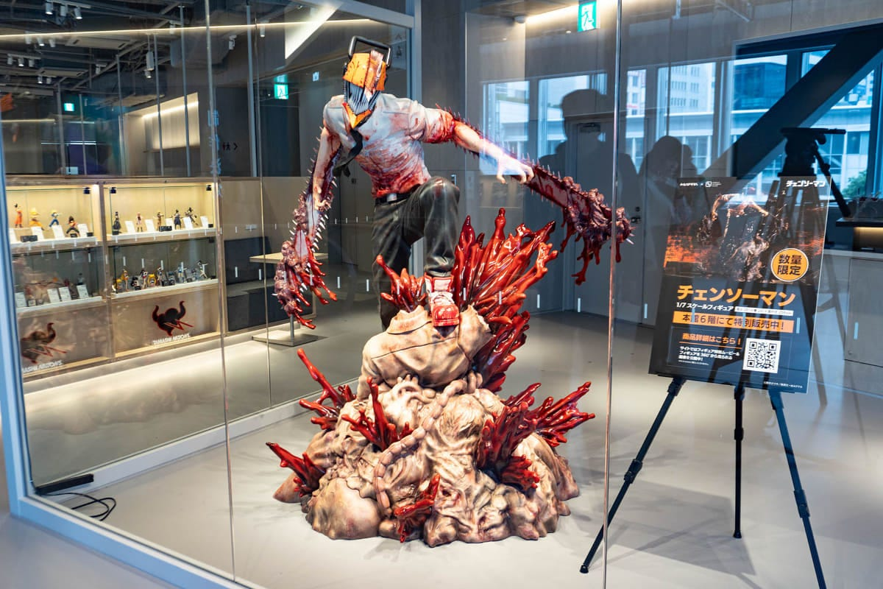
Impact of Anime on Japan
Shibuya:

Slide 36

Impact of Anime on Japan
Theme Parks:

Slide 37
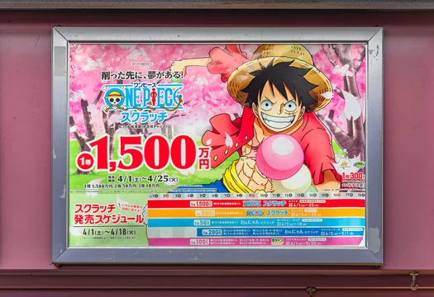
Impact of Anime on Japan
Advertisements:

Slide 38
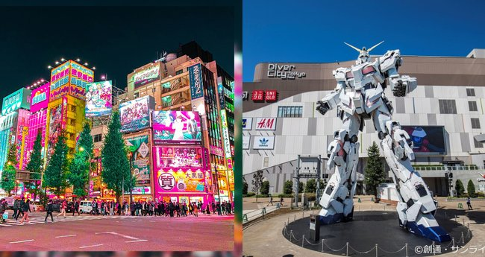
Impact of Anime on Japan
Tourism:

Slide 39
The World and Anime

Slide 40
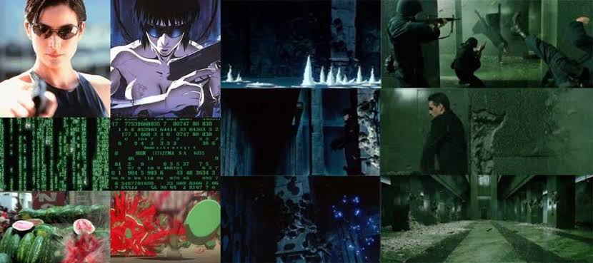
Pop Culture
Ghost in the shell

Slide 41
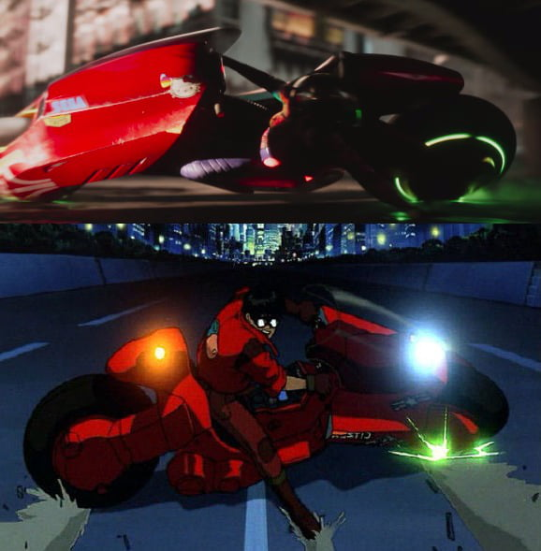
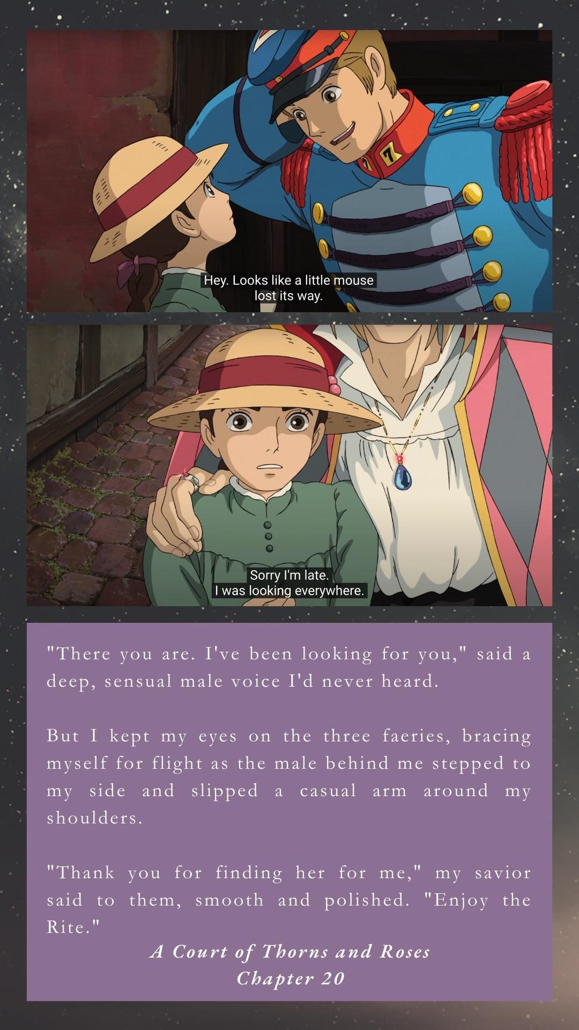
Pop Culture
Ready Player one & ACOTAR

Slide 42

Popularity
Ben Whittaker

Slide 43
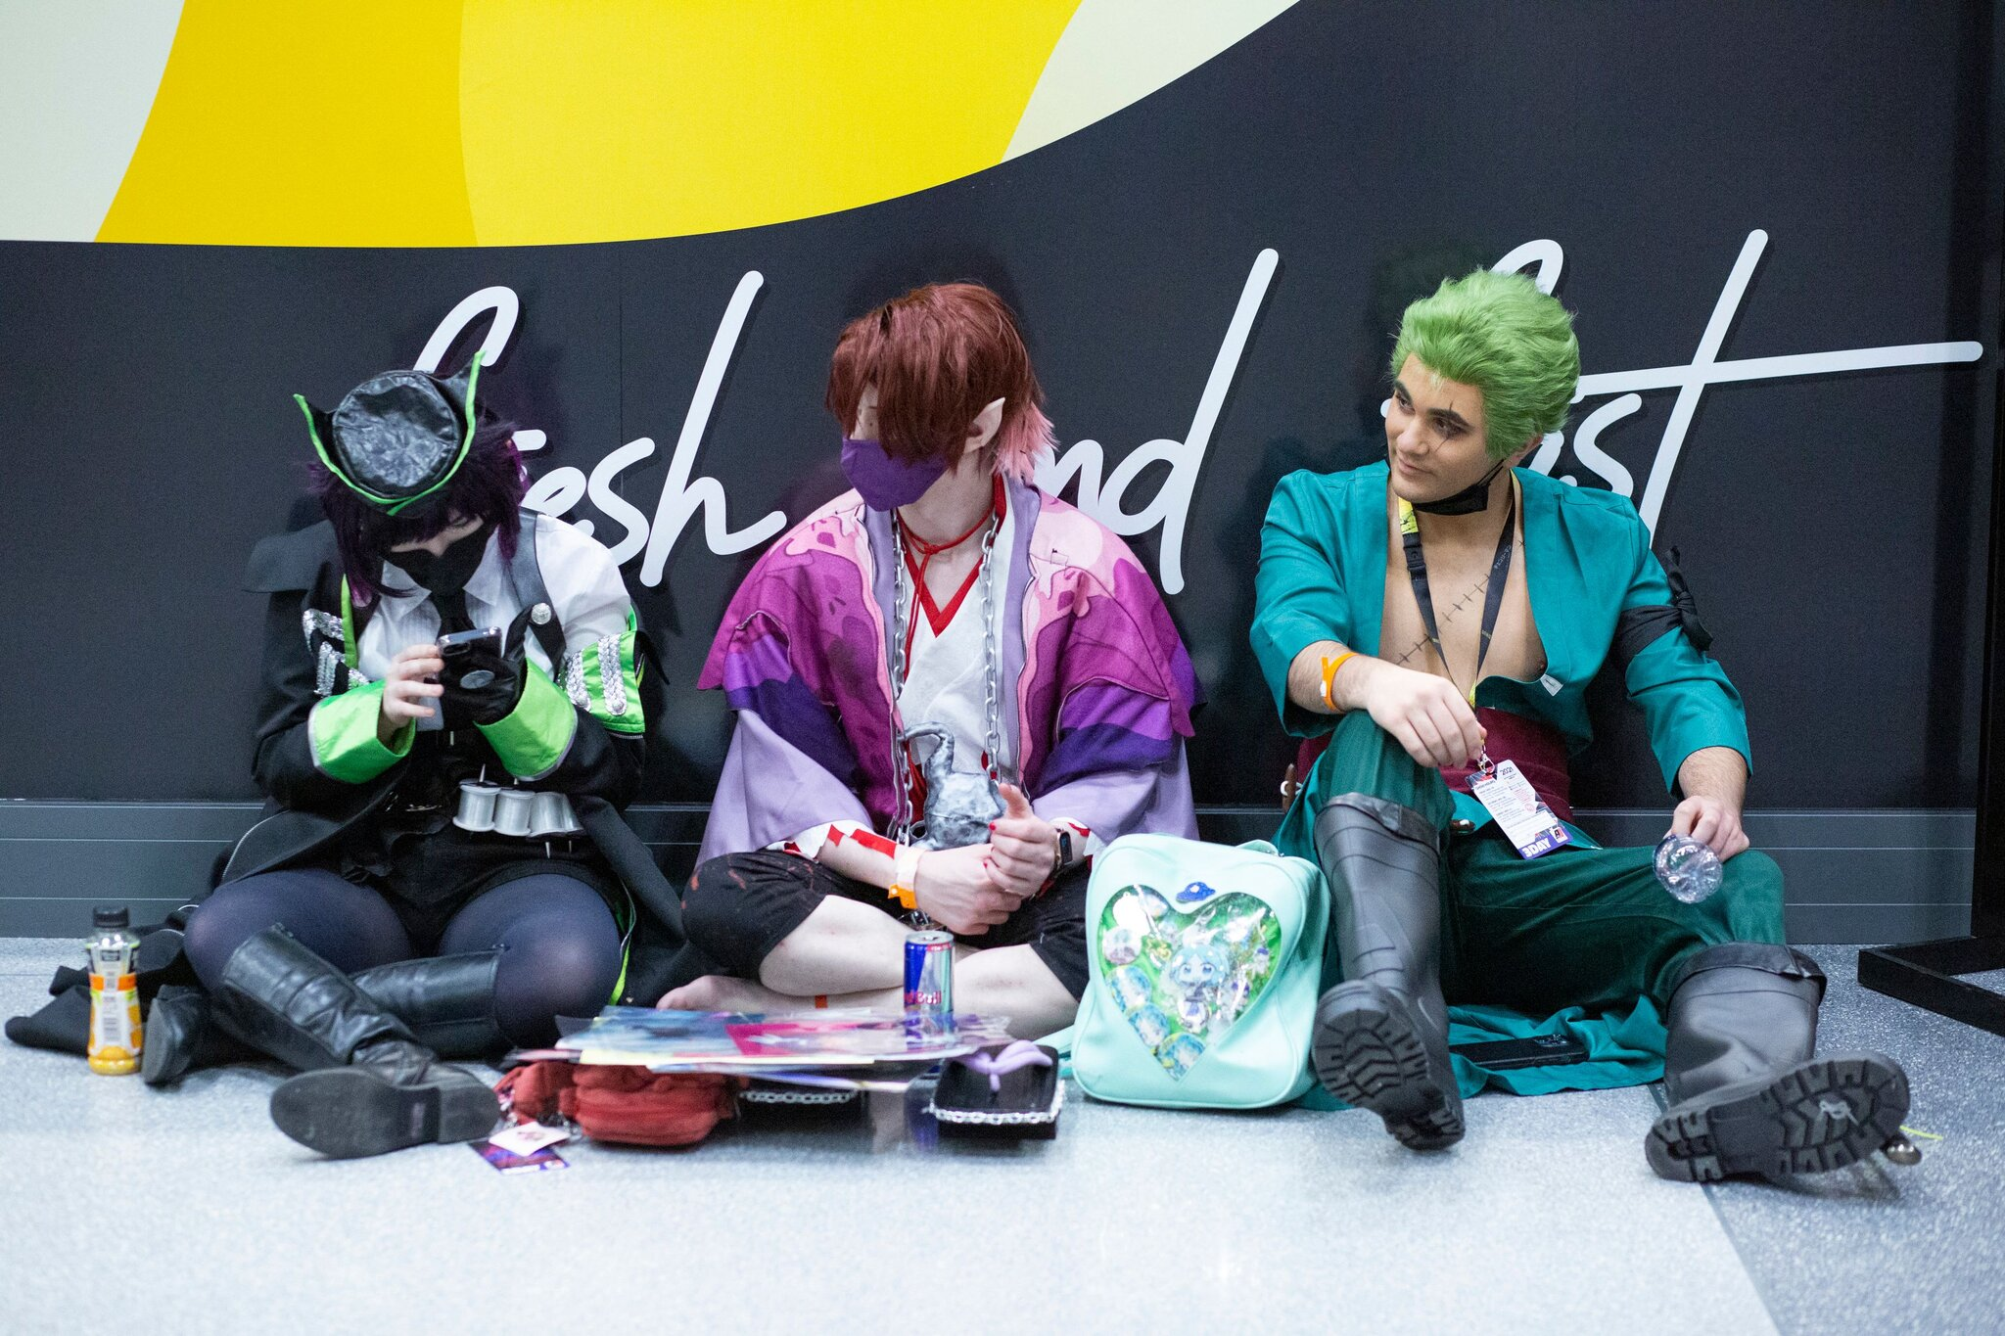
Popularity
Anime Con

Slide 44
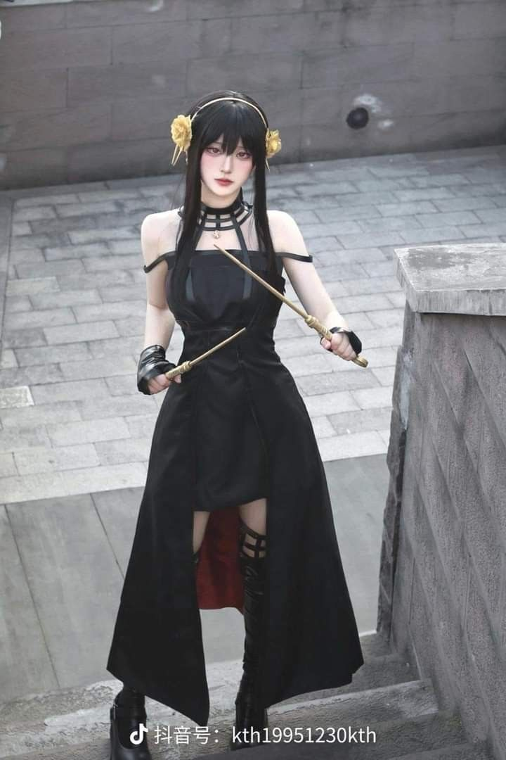

Popularity
Cosplays

Slide 45
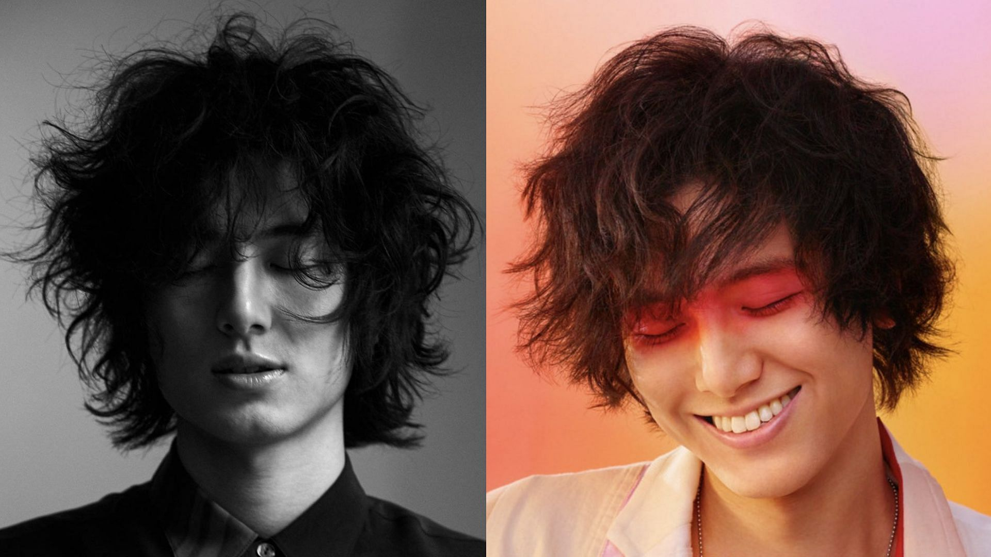
Popularity
J - pop

Slide 46

Popularity
Karmachakra (2017)

Slide 47
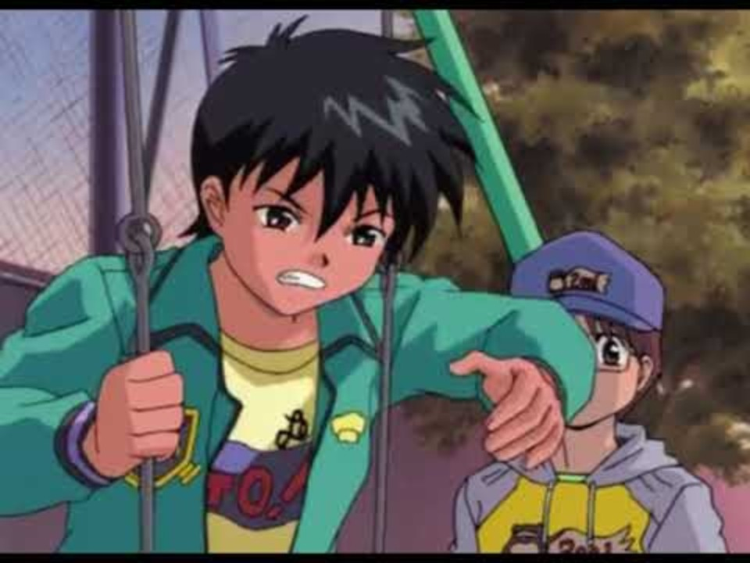
Bonus

Slide 48
Loanwords
Otaku
Weeb
Tsundere
Yandere
Moe
Arigato
Gyoza
Umami
Dojo
Sensei…

Slide 49
Appendix

Slide 50
Tokugawa Period
Tokugawa period, (1603–1867), the final period of traditional Japan, a time of internal peace, political stability, and economic growth under the shogunate (military dictatorship) founded by Tokugawa Ieyasu.

Slide 51
Sakoku

Slide 52
Ukiyo

Slide 53
Hokusai

Slide 54
The plaza accord

